Slide 1
CS0449: Introduction to System Software
SHINWOO KIM
Shinwoo Kim
Teaching Assistant
shinwookim@pitt.edu
https://sites.pitt.edu/~shk148/
Spring 2023, Term 2234
Friday 12 PM Recitation
Jan 27th, 2023
with materials from
Luis Oliveira, Jon Misurda, and
and Suzanne Matthews et al.’s
Dive into Systems
Department of Computer Science
School of Computing & Information
University of Pittsburgh
REC-1: Basic of C Programming
Announcements
Comparing structs using sizeof()
Basic Input/Output using C standard library functions

Slide 2
Announcements
Slides/Example code can be found: https://sites.pitt.edu/~shk148/teaching/CS0449-2234/#handouts
Link in Discord (#announcements)
TA Office Hours Finalized
Updates will be posted to Discord
Day | Time/Location
Monday | 1:00 PM - 2:30 PM @ 5806 SENSQ
Tuesday | 3:00PM - 3:45PM @ 5712 SENSQ
Wednesday | 2:30PM @ 5710 SENSQ
Thursday | 1:00PM - 3:45PM @ 6408 SENSQ
Friday | 11:00AM - 12:00PM @ 5806 SENSQ
By appointment | Message me to schedule a meeting (in-person/virtual)

Slide 3
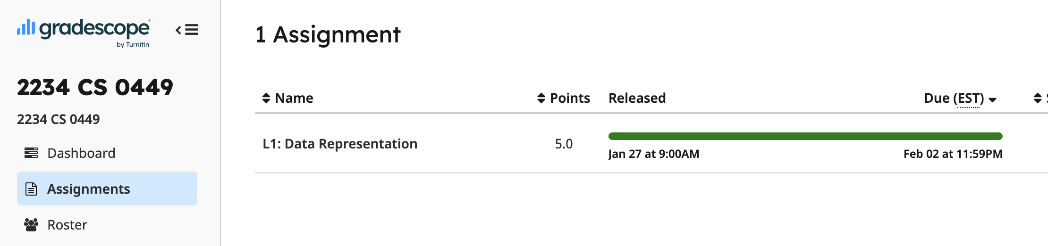
L1: Data Representation (Gradescope)
Practice 1 posted to Gradescope
L1: Data Representation
Binary, hexadecimal, decimal conversion
Bit-wise and logical operations
Bit shifting
Basic C syntax
Basic data types
int, float, etc.
signed, unsigned
Multiple choice, Fill-in-the-blanks

Slide 4
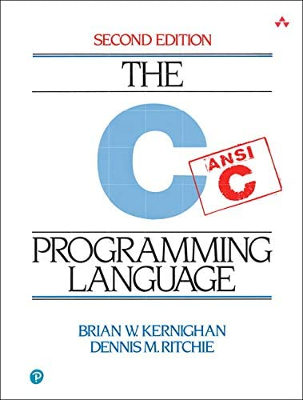
C Programming
Basic Input/Output using the C Standard Library

Slide 5
Standard C Library (libc)
In Lab0, you used printf() in the Hello World program
> printf("Hello world! x is currently %d \n", x);
> Hello world! x is currently 2
printf() stringified the arguments and printed to the standard output
formatted the string and filled-in the placeholders (e.g., %d)
Notice we didn’t need to implement that printf() function ourself
printf() is a function built-in to C’s standard I/O library
Hence, we needed to tell our compiler to make use of the standard library functions with #include <stdio.h>
You will talk about how the libraries are linked to your code in lecture soon
Notes:
stdout → the terminal

Slide 6
man gives us information about functions, commands, libraries
On most Unix/Unix-like systems, you can use man to learn more about functions/commands/etc.
The manual has the most accurate information about all the library functions, programs, commands, etc.
> Man printf
SCANF(3) Library Functions Manual SCANF(3)
NAME
printf, fprintf, ... , vsnprintf - formatted output conversion
SYNOPSIS
#include <stdio.h>
int printf(const char *restrict format, ...);
...
DESCRIPTION
The functions in the printf() family produce output according to a format as described below
...

Slide 7
Detailed look at using printf()
int printf(const char * format string, ...);
Returns an integer: number of characters printed (excluding null terminator)
Remember, in C, a string is just an array of characters
We place placeholders which begin with a percent sign (%). The variables which comes after the formatter will replace the placeholders when printing
#include <stdio.h>
int main()
{
printf("Name: %s, Info:\n", ”John");
printf("\tAge: %d \t Ht: %g\n",20,5.9);
printf("\tYear: %d \t Dorm: %s\n", 3,”Towers");
}
Name: John, Info:
Age: 20 Ht: 5.9
Year: 3 Dorm: Towers

Slide 8
Example code using printf() _{(animated)}
#include <stdio.h>
int main()
{
char ch = 'A';
char str[6] = "CS0449";
float flt = 10.234;
int num = 150;
double dbl = 20.126456;
printf("Character is %c \n", ch);
printf("String is %s \n", str);
printf("Float value is %f \n", flt);
printf("Integer value is %d\n", num);
printf("Double value is %f \n", dbl);
printf("Octal value is %o \n", num);
printf("Hexadecimal value is %x \n", num);
return 0;
}
Character is A
String is CS0449
Float value is 10.234000
Integer value is 150
Double value is 20.126456
Octal value is 226
Hexadecimal value is 96
http://sites.pitt.edu/~shk148/teaching/CS0449-2234/code/print.c.html

Slide 9
Reading Input using scanf()
Like printf(), scanf() is another C standard library function
Used to read character, string, numeric data from keyboard
Again, if you want to use it in your program you have to include the header ( #include <stdio.h> )
int scanf(const char * format, ...)
Returns an integer: number of input items successfully matched and assigned
Passes by reference (a pointer) to the variable which will hold our input
Defines what we are reading (character? Integer? Float?)

Slide 10
Example code using scanf() _{(live demo)}
#include <stdio.h>
int main()
{
char ch;
int x;
printf("Enter any character \n");
scanf("%c", &ch);
printf("Entered character is %c \n", ch);
printf("Enter any integer\n");
scanf("%d", &x);
printf("Entered integer is %d", x);
return 0;
}
http://sites.pitt.edu/~shk148/teaching/CS0449-2234/code/scan.c.html

